Slide 1
Economic Analysis (Theory +Practical) Credit: 3, Code: MDS 658 Full Marks: 75
CHAKRA B. KHADKA, PhD
Tribhuvan University
Institute of Science and Technology
School of Mathematical Sciences
Master's Degree Course in Data Science
March 2023

Slide 2
UNIT I ECONOMIC MODELS AND RECENT HISTORICAL APPLICATIONS
Relevance of economics to the world of business:
opportunity cost and scarcity and their relevance to economic choice,
economic concepts involved in choices made by businesses relevant to selection of outputs, inputs, technology, location and competition,
microeconomics and macroeconomics.

Slide 3
Relevance of economics to the world of business
Economics concerned with how society sets about meeting people's demands for things they want to consume.

Slide 4
Relevance of economics to the world of business
Economics looks at the production, consumption and sale of goods and services, both at the level of individual products, firms and consumers and at the level of the total production and consumption by countries.

Slide 5
Relevance of economics to the world of business
Economics also compares alternative ways of using the limited resources that countries and individuals possess and considers how efficient and/or fair such alternatives are.

Slide 6
Opportunity cost and scarcity
Scarcity
The resources we use to produce goods and services are limited.
Economics
The study of choices when there is scarcity.
Here are some examples of scarcity and the trade-offs associated with making choices:
You have a limited amount of time. If you take a full-time job, each hour on the job means one less hour for study or play.

Slide 7
Opportunity cost and scarcity
• Kathmandu city has a limited amount of land. If the city uses an acre of land for a park, it has one less acre for housing, retailers, or industry.
• You have limited income this year. If you spend Rs.1000 on K-95, that’s Rs.1000 less you have to spend on other products or to save.

Slide 8
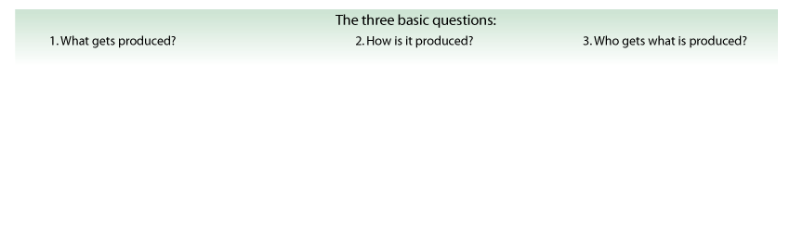



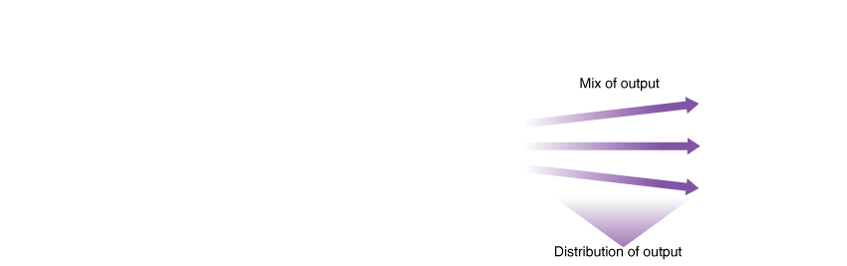

THE ECONOMIC PROBLEM: SCARCITY AND CHOICE

Slide 9
SCARCITY AND CHOICE
Factors of production: The resources used to produce goods and services; also known as production inputs.
Natural resources/Land: Resources provided by nature and used to produce goods and services.
Labor: The physical and mental effort people use to produce goods and services.
Human capital: The knowledge and skills acquired by a worker through education and experience.
Physical capital & Financial Capital: The stock of equipment, machines, structures, and infrastructure that is used to produce goods and services. Input of funds
Entrepreneurship: The effort used to coordinate the factors of production—natural resources, labor, physical capital, and human capital—to produce and sell products.

Slide 10
ANALYSIS OF ECONOMICS: Positive Versus Normative Analysis
positive analysis Answers the question “What is?” or “What will be?”
normative analysis Answers the question “What ought/should/ could/would to be?”
Table 1.1 COMPARING POSITIVE AND NORMATIVE QUESTIONS
Positive Questions |  |  | Normative Questions
• | If the government increases the minimum wage, how many workers will lose their jobs? | • | Should the government increase the minimum wage?
• | If two commercial banks merge, will the rate of interest increase? | • | Should the government block the merger of two commercial banks?
• | How does a college education affect a person’s productivity and earnings? | • | Should the government subsidize a college education?
• | How do consumers respond to a cut in income taxes? | • | Should the government cut taxes to stimulate the economy?
• | If a nation restricts drug imports, who benefits and who bears the cost? | • | Should the government restrict imports?

Slide 11
MICROECONOMICS AND MACROECONOMICS
Microeconomics: The study of how households and businesses make choices, how they interact in markets, and how the government attempts to influence their choices. Microeconomics with the binocular.
Macroeconomics: The study of the economy as a whole, including topics such as inflation, unemployment, economic growth National income etc. Macroeconomics without the binocular.

Slide 12
WHY ECONOMICS?
Two logical reasoning:
Deductive
Inductive

Slide 13
WHY IS ECONOMICS IMPORTANT?
Economics provides you with the knowledge and insight necessary to:-
Understand the impact of developments in business, society and the world economy
Enables you to understand the decisions of households, firms and governments based on human behavior, beliefs, structure, constraints and need.

Slide 14
Production Possibility Curve/Frontier
Country produces Good X and Good Y only. The table gives maximum production possibilities for Goods X and Y. Followings are four key assumptions:
Only two goods can be produced
Full employment of Resources
Fixed Resources (ceteris pluribus)
Fixed Technology

Slide 15
PPC
Point Units of Good X Units of Good Y
Illustration of tabulated value.
 | X | Y
A | 0 | 15
B | 1 | 13
C | 2 | 10
D | 3 | 6
E | 4 | 0

Slide 16
PPC
(i) Draw a production possibility curve marking points A, B, C, D and E.
(ii) Calculate the opportunity cost of increasing the output of Good X from 2 to 3 units.
(iii) Explain how and why the opportunity cost of producing higher levels of output of Good X
(iv) Describe the situation that must exist if the economy produces a combination of 2 units of Good X and 8 units of Good Y.

Slide 17
DEFINITIONS OF ECONOMICS
There are four well known definitions of economics. These are:
Classical view of economics: Wealth of Nation-Adam Smith
Neo-classical view of economics: Welfare Definition- Marshall
Modern view of economics: Scarcity Definition-Robbins
Growth movement: Definition- P.A. Samuelson

Slide 18
MICROECONOMICS PERSPECTIVES
Demand Theory
Supply Theory
Factor Pricing Theory (Distribution Theory)
Rent
Welfare Theory
Commodity Pricing Theory
Wage
Interest
Profit
MICRO ECONOMIC THEORY
To whom to Produce
How to Produce
When to Produce
What to
Produce

Slide 19
Importance and Uses of Microeconomics
Microeconomics deals with questions related to economic variables that describe a sub-national entity, typically individual economic agents, such as households and firms.
Individual Behavior Analysis
Resource Allocation
Price Mechanization
Economic Policy
Free Enterprise Economy
Social Welfare
Foreign Trade
Public Finance

Slide 20
UNIT I: Theory of Consumer Behavior (6 Hours)
Total and Marginal Utility. Consumer Equilibrium. Indifference Curves.
The Marginal Rate of Substitution. Characteristics of Indifference Curves.
The Budget Constraint Line. Consumer Equilibrium. The Price-Consumption Curve and the Consumer Demand Curve.
Separation of the Substitution and Income Effects.
Theory of revealed preference, Consumer Surplus, and Elasticity of Demand.
The problem of choice in situations involving Risk and Uncertainty (attitude towards risk and insurance).

Slide 21
Understanding Utility
Utility = Satisfaction/Happiness/Pleasure one gets from consuming a good.
Utility and usefulness are NOT the same in economics.
Utility is difficult to quantify, as it differs between people and situations
ie. A jacket to a person living in Jumla vs. a person living in Nepaljunj.
Measured in “utils” (a personal measure)
Usefulness is associated with those goods and services which are useful and are related to the betterment of the human beings.

Slide 22
Understanding Utility
Total Utility (TU)
Total amount of satisfaction or pleasure a person derives from consuming a given quantity of that product
Marginal Utility (MU)
The extra satisfaction a consumer derives from one additional unit of that product.
In other words, the change in Total Utility that results from the consumption of one more unit

Slide 23
Law of Diminishing Marginal Utility
Other things held constant/things are remaining the same diminishing marginal utility explains that the more of a good a person gets, the less utility he gets from each additional unit.
Consumer wants in general are wanting, but wants for particular items can be satisfied for a time.
Example: Durable goods such as an automobile

Slide 24
First is the Best
It is important to note that your marginal utility begins to fall after the very first unit you consume.
While you may enjoy your second units, it doesn’t bring as much utility as the first
At some point, your MU becomes negative. (takes away from your total satisfaction).

Slide 25
Law of Diminishing Marginal Utility
MU=Change in TU/Change in Q
Total Utility
30
(1)
Tacos
Consumed
Per Meal
(2)
Total
Utility,
Utils
(3)
Marginal
Utility,
Utils
TU
20
Total Utility (Utils)
0
1
2
3
4
5
6
7
0
10
18
24
28
30
30
28
]
10
8
6
4
2
0
-2
10
]
]
0
1
2
3
4
5
6
7
]
Units Consumed Per Meal
]
Marginal Utility
Marginal can be define midway or mid half between to condition
10
]
8
]
6
Marginal Utility (Utils)
4
2
0
-2
MU
1
2
3
4
5
6
7
Units Consumed Per Meal

Slide 26
2. Utility Maximization
Explains how consumers allocate their money incomes among the many goods and services available for purchase
You will be faced with problems that provide you with a consumer’s MU or TU derived from purchasing 2 goods. You will be expected to show how many of each a rational consumer would purchase.

Slide 27
Theory of Consumer Behavior
Numerical Example:
Find the Utility-Maximizing Combination of
A and B, if you have an Income of Rs.10
(2)
Product A:
Price = Rs.1
(3)
Product B:
Price = Rs.2
(b)
Marginal
Utility
Per Rs.
(MU/Price)
(b)
Marginal
Utility
Per Rs.
(MU/Price)
(a)
Marginal
Utility,
Utils
(a)
Marginal
Utility,
Utils
(1)
Unit of
Product
First
Second
Third
Fourth
Fifth
Sixth
Seventh
10
8
7
6
5
4
3
10
8
7
6
5
4
3
24
20
18
16
12
6
4
12
10
9
8
6
3
2

Slide 28
Theory of Consumer Behavior
Numerical Example:
Utility-Maximizing Combination of Products A and B Obtainable with an Income of Rs.10
(2)
Product A:
Price = Rs.1
(3)
Product B:
Price = Rs.2
(b)
Marginal
Utility
Per Rs.
(MU/Price)
(b)
Marginal
Utility
Per Rs.
(MU/Price)
(a)
Marginal
Utility,
Utils
(a)
Marginal
Utility,
Utils
(1)
Unit of
Product
First
Second
Third
Fourth
Fifth
Sixth
Seventh
10
8
7
6
5
4
3
10
8
7
6
5
4
3
24
20
18
16
12
6
4
12
10
9
8
6
3
2
Compare Marginal Utilities
Then Compare Per Dollar - MU/Price
Choose the Highest
Check Budget - Proceed to Next Item

Slide 29
Theory of Consumer Behavior
Numerical Example:
Utility-Maximizing Combination of Products A and B Obtainable with an Income of $10
(2)
Product A:
Price = $1
(3)
Product B:
Price = $2
(b)
Marginal
Utility
Per Dollar
(MU/Price)
(b)
Marginal
Utility
Per Dollar
(MU/Price)
(a)
Marginal
Utility,
Utils
(a)
Marginal
Utility,
Utils
(1)
Unit of
Product
First
Second
Third
Fourth
Fifth
Sixth
Seventh
10
8
7
6
5
4
3
10
8
7
6
5
4
3
24
20
18
16
12
6
4
12
10
9
8
6
3
2
Again, Compare Per Dollar - MU/Price
Choose the Highest
Buy One of Each – Budget Has $5 Left
Proceed to Next Item

Slide 30
Theory of Consumer Behavior
Numerical Example:
Utility-Maximizing Combination of Products A and B Obtainable with an Income of Rs.10
(2)
Product A:
Price = Rs.1
(3)
Product B:
Price = Rs.2
(b)
Marginal
Utility
Per Rs.
(MU/Price)
(b)
Marginal
Utility
Per Rs.
(MU/Price)
(a)
Marginal
Utility,
Utils
(a)
Marginal
Utility,
Utils
(1)
Unit of
Product
First
Second
Third
Fourth
Fifth
Sixth
Seventh
10
8
7
6
5
4
3
10
8
7
6
5
4
3
24
20
18
16
12
6
4
12
10
9
8
6
3
2
Again, Compare Per Rs. - MU/Price
Buy One More B – Budget Has Rs.3 Left Proceed to Next Item

Slide 31
Theory of Consumer Behavior
Numerical Example:
Utility-Maximizing Combination of Products A and B Obtainable with an Income of Rs.10
(2)
Product A:
Price = Rs.1
(3)
Product B:
Price = Rs.2
(b)
Marginal
Utility
Per Rs.
(MU/Price)
(b)
Marginal
Utility
Per Rs.
(MU/Price)
(a)
Marginal
Utility,
Utils
(a)
Marginal
Utility,
Utils
(1)
Unit of
Product
First
Second
Third
Fourth
Fifth
Sixth
Seventh
10
8
7
6
5
4
3
10
8
7
6
5
4
3
24
20
18
16
12
6
4
12
10
9
8
6
3
2
Again, Compare Per Rs. - MU/Price
Buy One of Each – Budget Exhausted

Slide 32
Theory of Consumer Behavior
Numerical Example:
Utility-Maximizing Combination of Products A and B Obtainable with an Income of $10
(2)
Product A:
Price = $1
(3)
Product B:
Price = $2
(b)
Marginal
Utility
Per Dollar
(MU/Price)
(b)
Marginal
Utility
Per Dollar
(MU/Price)
(a)
Marginal
Utility,
Utils
(a)
Marginal
Utility,
Utils
(1)
Unit of
Product
First
Second
Third
Fourth
Fifth
Sixth
Seventh
10
8
7
6
5
4
3
10
8
7
6
5
4
3
24
20
18
16
12
6
4
12
10
9
8
6
3
2
Final Result – At These Prices, Purchase 2 of Item A and 4 of B

Slide 33
Theory of Consumer Behavior
Algebraic Restatement:
MU of Product A
MU of Product B
=
Price of A
Price of B
8 Utils
16 Utils
=
Rs.1
Rs.2
Optimum Achieved - Money Income is Allocated so that the Last Rs. Spent on Each Good Yields the Same Extra or Marginal Utility

Slide 34
Two-Good Practice Problem
Given MU, and an income/budget constraint of Rs.20… find the Utility-Maximizing Combination of A and B
(2)
Product A:
Price = Rs.2
(3)
Product B:
Price = Rs.5
Unit | MU |  | Unit | MU
1 | 20 |  | 1 | 30
2 | 10 |  | 2 | 20
3 | 6 |  | 3 | 15
4 | 3 |  | 4 | 5
5 | 1 |  | 5 | -5

Slide 35
Two-Good Practice Problem
Given TU, and an income/budget constraint of Rs.9… find the Utility-Maximizing Combination of A and B
(2)
Product A:
Price = Rs.2
(3)
Product B:
Price = Rs.1
Unit | TU |  | Unit | TU
1 | 22 |  | 1 | 10
2 | 32 |  | 2 | 16
3 | 40 |  | 3 | 20
4 | 46 |  | 4 | 22
5 | 48 |  | 5 | 20

Slide 36
From ‘Utils’ to ‘Benefit’
Because Utils cannot be compared between people, and cannot be compared to Rs… economists must measure satisfaction in Benefit.
Benefit is the same concept as utility, but it is measured in Rs. (according to the consumer’s WILLINGNESS TO PAY.
Total Benefit (Rs.), Marginal Benefit (Rs.)

Slide 37
Golden Rule of Consumption
A rational consumer will continue to purchase until…
MB = MC
To consume one more would mean your marginal cost is greater than your marginal benefit

Slide 38
Individual and Market Demand Curves
Start with an individual consumer
maybe you, maybe me, but could be anyone
Derive demand curve for that individual
focus on marginal utility or marginal benefit
Add up demand curves for many such individuals to get market demand curve

Slide 39
Assumption about consumer behavior
General economic principle
People
make purposeful choices
with limited resources
When applied to the behavior of consumers
People
maximize utility
subject to a budget constraint

Slide 40
Individual and Market Demand Curves
Consider all consumers in the market
Add up quantity demanded by all individuals at each price to get market demand
Add horizontally to create market demand curve

Slide 41
THE THEORY OF CONSUMER CHOICE
The theory of consumer choice addresses the following questions:
Do all demand curves slope downward?
How do wages affect labor supply?
How do interest rates affect household saving?

Slide 42
THE BUDGET CONSTRAINT: WHAT THE CONSUMER CAN AFFORD
The budget constraint illustrate the limit on the consumption “bundles” that a consumer can afford.
People consume less than they desire because their spending is constrained, or limited, by their income.

Slide 43
THE BUDGET CONSTRAINT: WHAT THE CONSUMER CAN AFFORD
The budget constraint shows the various combinations of goods the consumer can afford given his or her income and the prices of the two goods.

Slide 44
Figure 1 The Consumer’s Budget Constraint
Pints of Pepsi | Number of Pizzas | Spending on Pepsi Rs. | Spending on Pizza Rs. | Total Spending Rs.
0 | 100 | 0 | 1000 | 1000
50 | 90 | 100 | 900 | 1000
100 | 80 | 200 | 800 | 1000
150 | 70 | 300 | 700 | 1000
200 | 60 | 400 | 600 | 1000
250 | 50 | 500 | 500 | 1000
300 | 40 | 600 | 400 | 1000
350 | 30 | 700 | 300 | 1000
400 | 20 | 800 | 200 | 1000
450 | 10 | 900 | 100 | 1000
500 | 0 | 1000 | 0 | 1000

Slide 45
THE BUDGET CONSTRAINT: WHAT THE CONSUMER CAN AFFORD
The Consumer’s Budget Constraint
Any point on the budget constraint line indicates the consumer’s combination or trade-off between two goods.
For example, if the consumer buys no pizzas, s/he can afford 500 pints of Pepsi (point B). If s/he buys no Pepsi, s/he can afford 100 pizzas (point A).

Slide 46

The Consumer’s Budget Constraint
Quantity
of Pepsi
500
B
A
0
100
Quantity
of Pizza

Slide 47
THE BUDGET CONSTRAINT: WHAT THE CONSUMER CAN AFFORD
The Consumer’s Budget Constraint
Alternately, the consumer can buy 50 pizzas and 250 pints of Pepsi.

Slide 48
The Consumer’s Budget Constraint
Quantity
of Pepsi
B
500
C
250
Consumer’s
budget constraint
A
0
50
100
Quantity
of Pizza

Slide 49
THE BUDGET CONSTRAINT: WHAT THE CONSUMER CAN AFFORD
The slope of the budget constraint line equals the relative price of the two goods, that is, the price of one good compared to the price of the other.
It measures the rate at which the consumer can trade one good for the other.

Slide 50
PREFERENCES: WHAT THE CONSUMER WANTS/CHOICE
A consumer’s preference among consumption bundles may be illustrated with indifference curves.

Slide 51
Representing Preferences with Indifference Curves
An indifference curve is a curve that shows consumption bundles that give the consumer the same level of satisfaction.

Slide 52
The Consumer’s Preferences
Quantity
of Pepsi
C
B
D
I₂
Indifference
A
curve,
I₁
0
Quantity
of Pizza

Slide 53
Indifference curves are convex to the origin
IC are convex to the origin because they follow the law of DMRSxy​ (Diminishing marginal rate of substitution).

Slide 54
REPRESENTING PREFERENCES WITH INDIFFERENCE CURVES
The Consumer’s Preferences
The consumer is indifferent, or equally happy, with the combinations shown at points A, B, and C because they are all on the same curve.
The Marginal Rate of Substitution
The slope at any point on an indifference curve is the marginal rate of substitution.
It is the rate at which a consumer is willing to trade one good for another.
It is the amount of one good that a consumer requires as compensation to give up one unit of the other good.

Slide 55
The Consumer’s Preferences
Quantity
of Pepsi
C
B
D
MRS
I₂
1
Indifference
A
curve,
I₁
0
Quantity
of Pizza

Slide 56
FOUR PROPERTIES OF INDIFFERENCE CURVES
Higher indifference curves are preferred to lower ones.
Indifference curves are downward sloping.
Indifference curves do not cross.
Indifference curves are bowed inward.

Slide 57
FOUR PROPERTIES OF INDIFFERENCE CURVES
Property 1: Higher indifference curves are preferred to lower ones.
Consumers usually prefer more of something to less of it.
Higher indifference curves represent larger quantities of goods than do lower indifference curves.

Slide 58
The Consumer’s Preferences
Quantity
of Pepsi
C
B
D
I₂
Indifference
A
curve,
I₁
0
Quantity
of Pizza

Slide 59
FOUR PROPERTIES OF INDIFFERENCE CURVES
Property 2: Indifference curves are downward sloping.
A consumer is willing to give up one good only if he or she gets more of the other good in order to remain equally happy.
If the quantity of one good is reduced, the quantity of the other good must increase to keep the consumer equally happy.
For this reason, most indifference curves slope downward.

Slide 60
The Consumer’s Preferences
Quantity
of Pepsi
Indifference
curve,
I₁
0
Quantity
of Pizza

Slide 61
FOUR PROPERTIES OF INDIFFERENCE CURVES
Property 3: Indifference curves do not cross.
Points A and B should make the consumer equally happy.
Points B and C should make the consumer equally happy.
This implies that A and C would make the consumer equally happy.
But C has more of both goods compared to A.

Slide 62
The Impossibility of Intersecting Indifference Curves
Quantity
of Pepsi
C
A
B
0
Quantity
of Pizza

Slide 63
FOUR PROPERTIES OF INDIFFERENCE CURVES
Property 4: Indifference curves are bowed inward.
People are more willing to trade away goods that they have in abundance and less willing to trade away goods of which they have little.
These differences in a consumer’s marginal substitution rates cause his or her indifference curve to bow inward.

Slide 64
Bowed Indifference Curves
Quantity
of Pepsi
14
MRS
= 6
8
A
1
4
MRS
= 1
B
3
1
Indifference
curve
0
2
3
6
7
Quantity
of Pizza

Slide 65
TWO EXTREME EXAMPLES OF INDIFFERENCE CURVES
Perfect substitutes
Perfect complements

Slide 66
TWO EXTREME EXAMPLES OF INDIFFERENCE CURVES
Perfect Substitutes
Two goods with straight-line indifference curves are perfect substitutes.
The marginal rate of substitution is a fixed number.

Slide 67
Perfect Substitutes and Perfect Complements
(a) Perfect Substitutes
Bikram
6
4
2
I₁
I₂
I₃
0
1
2
3
Sunita

Slide 68
TWO EXTREME EXAMPLES OF INDIFFERENCE CURVES
Perfect Complements
Two goods with right-angle indifference curves are perfect complements.
Since these goods are always used together, extra units of one good, outside the desired consumption ratio, add no additional satisfaction.

Slide 69
Perfect Substitutes and Perfect Complements
(b) Perfect Complements
Left
Shoes
I₂
7
5
I₁
0
5
7
Right Shoes

Slide 70
OPTIMIZATION: WHAT THE CONSUMER CHOOSES
Consumers want to get the combination of goods on the highest possible indifference curve.
However, the consumer must also end up on or below her budget constraint.

Slide 71
THE CONSUMER’S OPTIMAL CHOICES
Combining the indifference curve and the budget constraint determines the consumer’s optimal choice.
Consumer optimum occurs at the point where the highest indifference curve and the budget constraint are tangent.

Slide 72
THE CONSUMER’S OPTIMAL CHOICE
The consumer chooses consumption of the two goods so that the marginal rate of substitution equals the relative price.
At the consumer’s optimum, the consumer’s valuation of the two goods equals the market’s valuation.

Slide 73
The Consumer’s Optimum
Quantity
of Pepsi
The consumer would prefer to be on indifference curve I₃, but does not have enough income to reach that indifference curve.
Optimum
The consumer can afford most of the bundles on I₁, but why stay there when you can move out to a higher indifference curve, I₂?
B
A
I₃
I₂
I₁
Budget constraint
0
Quantity
of Pizza

Slide 74
HOW CHANGES IN INCOME AFFECT THE CONSUMER’S CHOICES
An increase in income shifts the budget constraint outward.
The consumer is able to choose a better combination of goods on a higher indifference curve.

Slide 75
Consumer Equilibrium
Consumers’ equilibrium means a state of maximum satisfaction.
A situation where a consumer spends his given income purchasing one or more commodities so that he gets maximum satisfaction and has no urge to change this level of consumption, given the prices of commodities, is known as the consumers’ equilibrium.

Slide 76
INCREASING INCOME
How does an increase in income influence the consumer’s budget constraint?
If we double our consumer’s Rs.1000 income, how much Pepsi can she buy if no pizza?
How much pizza if no Pepsi?

Slide 77
The Consumer’s Income Increase
Quantity
of Pepsi
B
500
C
250
C
175
Consumer’s
budget constraint
A
0
50
100
Quantity
40
of Pizza

Slide 78
The Consumer’s Income Increase
Quantity
of Pepsi
B
500
C
250
Consumer’s
A
budget constraint
0
50
100
Quantity
of Pizza

Slide 79
The Consumer’s Income Increase
Quantity
of Pepsi
500
B
A
0
100
Quantity
of Pizza

Slide 80
An Increase in Income
Quantity
of Pepsi
New budget constraint
1. An increase in income shifts the
budget constraint outward . . .
New optimum
3. . . . and
Pepsi
Initial
consumption.
optimum
I₂
Initial
budget
I₁
constraint
0
Quantity
2. . . . raising pizza consumption . . .
of Pizza

Slide 81
HOW CHANGES IN INCOME AFFECT THE CONSUMER’S CHOICES
Normal versus Inferior Goods
If a consumer buys more of a good when his or her income rises, the good is called a normal good.
If a consumer buys less of a good when his or her income rises, the good is called an inferior good.

Slide 82
An Inferior Good
Quantity
of Pepsi
New budget constraint
1. When an increase in income shifts the
3. . . . but
Initial
budget constraint outward . . .
Pepsi
optimum
consumption
falls, making
New optimum
Pepsi an
inferior good.
Initial
budget
I₁
I₂
constraint
0
Quantity
2. . . . pizza consumption rises, making pizza a normal good . . .
of Pizza

Slide 83
INFERIOR GOODS
Is Pepsi really an inferior good for you? For most people? Is pizza a normal good or an inferior good for you?
What are some examples of inferior goods?

Slide 84
HOW CHANGES IN PRICES AFFECT CONSUMER’S CHOICES
How does a decrease in the price of Pepsi from Rs.2 to Rs.1 per liter change the budget constraint for our consumer?

Slide 85
HOW CHANGES IN PRICES AFFECT CONSUMER’S CHOICES
A fall in the price of any good rotates the budget constraint outward and changes the slope of the budget constraint.

Slide 86
A Change in Price
Quantity
of Pepsi
1,000
D
New budget constraint
New optimum
500
B
1. A fall in the price of Pepsi rotates
the budget constraint outward . . .
3. . . . and
raising Pepsi
Initial optimum
consumption.
Initial
I₂
budget
I₁
constraint
A
0
100
Quantity
2. . . . reducing pizza consumption . . .
of Pizza

Slide 87
INCOME AND SUBSTITUTION EFFECTS
A price change has two effects on consumption.
An income effect
A substitution effect

Slide 88
INCOME AND SUBSTITUTION EFFECTS
The Income Effect
The income effect is the change in consumption that results when a price change moves the consumer to a higher or lower indifference curve.
The Substitution Effect
The substitution effect is the change in consumption that results when a price change moves the consumer along an indifference curve to a point with a different marginal rate of substitution.

Slide 89
INCOME AND SUBSTITUTION EFFECTS
A Change in Price: Substitution Effect
A price change first causes the consumer to move from one point on an indifference curve to another on the same curve.
Illustrated by movement from point A to point B.
A Change in Price: Income Effect
After moving from one point to another on the same curve, the consumer will move to another indifference curve.
Illustrated by movement from point B to point C.

Slide 90
Figure 10 Income and Substitution Effects
Quantity
of Pepsi
New budget constraint
C
New optimum
Income
effect
B
Initial optimum
Substitution
Initial
effect
budget
constraint
A
I₂
I₁
0
Quantity
Substitution effect
of Pizza
Income effect

Slide 91
Income and Substitution Effects When the Price of Pepsi Falls

Slide 92
DERIVING THE DEMAND CURVE
A consumer’s demand curve can be viewed as a summary of the optimal decisions that arise from his or her budget constraint and indifference curves.

Slide 93
Deriving the Demand Curve
(a) The Consumer
’
s Optimum
(b) The Demand Curve for Pepsi
Quantity
Price of
of Rice kg
New budget constraint
of Rice kg
750
B
$2
A
I₂
B
A
1
250
Demand
I₁
0
Initial budget
0
250
750
constraint
Quantity of Wheat kg
Quantity of Wheat kg

Slide 94
Revealed preference theory
Revealed preference theory, in economics, a theory, introduced by the American economist Paul Anthony Samuelson in 1938, clamps that consumers’ preferences can be revealed by what they purchase under different circumstances, particularly under different income and price circumstances.
The theory entails that if a consumer purchases a specific bundle of goods, then that bundle is “revealed preferred,” given constant income and prices, to any other bundle that the consumer could afford.
By varying income or prices or both, an observer can infer a representative model of the consumer’s preferences.

Slide 95
The revealed preference hypothesis
The revealed preference hypothesis is considered a major breakthrough in the theory of demand because it has made possible the establishment of the 'law of demand' directly (on the basis of the revealed preference axiom) without the use of indifference curves and all their restrictive assumptions.

Slide 96
The revealed preference hypothesis
Regarding the ordering of consumers' preferences, the revealed preference hypothesis has the advantage over the Hicks-Allen approach of establishing the existence and the convexity of the indifference curves.
However, the indifference curves are surplus in the derivation of the demand curve. Let us first examine the derivation of the 'law of demand'; then show how indifference curves can be established.

Slide 97
Revealed Preference Approach
The theory of revealed preference shows how the choices that individuals make when prices and income vary can be used to determine their preferences.
When an individual chooses basket A even though S/he could afford B, we know that A is preferred to B.

Slide 98
Assumptions
Rationality: The consumer is assumed to behave rationally, in that he prefers bundles of goods that include more quantities of the commodities.
Consistency: The consumer behaves consistently, that is if he chooses bundle A in a situation in which bundle B was also available to him he will not choose B in any other situation in which A is also available.
Symbolically if A > B, then B not > A
3. Transitivity: If in any particular situation A > B and B > C, then A > C.

Slide 99
Assumptions
4. The revealed preference axiom (Saying): The consumer, by choosing a collection of goods in any one budget situation, reveals his preference for that particular collection.
The chosen bundle is revealed to be preferred among all other alternative bundles available under the budget constraint.
The chosen ‘basket of goods’ maximizes the utility of the consumer.
The revealed preference for a particular collection of goods implies (axiomatically) the maximization of the utility of the consumer.

Slide 100
Derivation of the demand curve
Assume that the consumer has the budget line AB in figure illustrated below and chooses the collection of goods denoted by point Z, thus revealing his preference for this batch. Suppose that the price of x falls so that the new budget line facing the consumer is A C.
Let show that the new batch will include a larger quantity of x.

Slide 101
Derivation of the demand curve
Y
Y
A
A’
Z
N
W
X
0
X1
X2
B
X3
B’
C

Slide 102
Derivation of the demand curve
Firstly, we make a 'compensating variation' of the income, which consists of the reduction of income so that the consumer has just enough income to enable him to continue purchasing Z if he so wishes.
The compensating variation is shown in the figure above by a parallel shift of the new budget line so that the 'compensated' budget line A'B' passes through Z.

Slide 103
Derivation of the demand curve
Since collection Z is still available to him, the consumer will not choose any bundle to the left of Z on the segment A'Z, because his choice would be inconsistent, given that in the original situation all the batches on A'Z were revealed inferior to Z.

Slide 104
Derivation of the demand curve
Hence the consumer will either continue to buy Z (in which case the substitution effect is zero) or he will choose a batch on the segment ZB', such as W, which includes a larger quantity of x (namely x 2 ).
Secondly, if we remove the (fictitious) reduction in income and allow the consumer to move on to the new budget line AC, he will choose a batch (such as N) to the right of W (if the commodity x is normal with a positive income effect).

Slide 105
Derivation of the demand curve
The newly revealed equilibrium position (N) includes a larger quantity of x (i.e. x 3 ) resulting from the fall in its price.
Thus the revealed preference axiom and the implied consistency of choice open a direct way to the derivation of the demand curve: as the price falls, more of x is purchased.

Slide 106
Derivation of the indifference curves
Although not needed for establishing the law of demand, indifference curves can be derived and their convexity is proved by the revealed preference hypothesis.
The indifference-curves approach requires less information than the neoclassical cardinal utility theory. But still, it requires a lot from the consumer since the theory expects him to be able to rank rationally and consistently all possible collections of commodities.

Slide 107
Derivation of the indifference curves
Samuelson's revealed preference theory does not require the consumer to rank his preferences or to give any other information about his tastes.

Slide 108
Derivation of the indifference curves
The revealed preference permits us to construct the indifference map of the consumer just by observing his behavior (his choice) at various market prices, provided that:
(a) his choice is consistent,
(b) his tastes are independent of his choices over time and do not change,
(c) that the consumer is rational in the Pareto sense, that is, he prefers more goods to less.

Slide 109
Derivation of the indifference curves
Y
Ignorance Zone
Y
A
C
Preferred Zone
Z
D
Inferior Zone
Ignorance Zone
X
0
B

Slide 110
Derivation
Assume that the initial budget line of the consumer is AB in figure 2.16 and he chooses batch Z.
All the other points on the budget line and below it denote inferior batches to Z. If we draw perpendiculars through Z, CZ, and ZD, all the batches on these lines, and in the area defined by them to the right of Z, are preferred to Z because they contain more quantity of at least one commodity.

Slide 111
Derivation
Batches of goods in the remaining area (below CZD and above the budget line) are still not ordered. However, we may rank them relative to Z by adopting the following procedure.

Slide 112
Let the price of x falls so that the new budget line EF passes below Z (figure).
Y
C
Y
A
Z
D
E
G
X
0
B
F

Slide 113
Derivation
The consumer will choose either G or a point to the right of G (on GF), since points on EG would imply inconsistent choice, being below the original budget line and hence inferior to G. Assume that the consumer chooses G. Using the transitivity assumption we have:
Hence,
Z>G G > (GBF) Z > (GBF)
(in the original situation) (in

Slide 114
Derivation
In this way, we managed to rank all the batches in GBF relative to Z.
We may repeat this procedure by drawing budget lines below Z and defining gradually all the batches of the 'lower ignorance zone' that are inferior to Z.

Slide 115
Two Axioms of Revealed Preference
To apply revealed preference analysis, choices must satisfy two criteria:
Weak Axioms of Revealed Preference
Strong Axioms of Revealed Preference

Slide 116
Strong and Weak Axioms of Revealed Preference
As revealed preference theory developed, three primary axioms (principle) were identified: the weak, strong, and generalized axioms of revealed preference.
The weak axiom indicates that, at given prices and incomes, if one good is purchased rather than another, then the consumer will always make the same choice.

Slide 117
Strong and Weak Axioms of Revealed Preference
Less abstractly, the weak axiom argues that if a consumer purchases one particular type of good, then the consumer will never purchase a different brand or good unless it provides more benefits by being less expensive, having better quality, or providing increased convenience.
Even more directly, the weak axiom indicates that consumers will purchase what they prefer and will make consistent choices.

Slide 118
Strong and Weak Axioms of Revealed Preference
The strong axiom essentially generalizes the weak axiom to cover multiple goods and rules out certain inconsistent chains of choices.
In a two-dimensional world (a world with only two goods between which consumers choose), the weak and strong axioms can be shown to be equivalent.

Slide 119
Strong and Weak Axioms of Revealed Preference
While the strong axiom characterizes the implications of utility maximization (see expected utility), it does not address all the implications namely, there may not be a unique maximum.
The generalized axiom covers the case when, for a given price level and income, more than one consumption bundle satisfies the same level of benefit. Expressed in utility terms, the generalized axiom accounts for circumstances where there is no unique bundle that maximizes utility.

Slide 120
Strong and Weak Axioms of Revealed Preference
The two most-distinguishing characteristics of revealed preference theory are as follows:
1) it offers a theoretical framework for explaining consumer behavior predicated on little more than the assumption that consumers are rational, that they will make choices that advance their own purposes most efficiently, and
2) it provides necessary and sufficient conditions, which can be empirically tested, for observed choices to be consistent with utility maximization.

Slide 121
Consumer Surplus

Slide 122
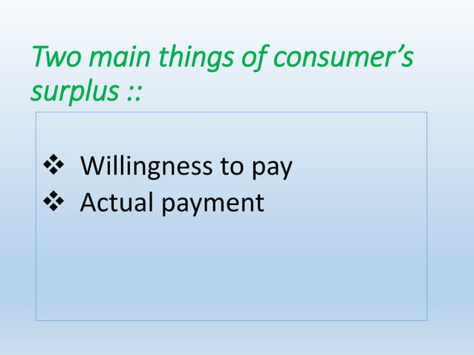

Slide 123
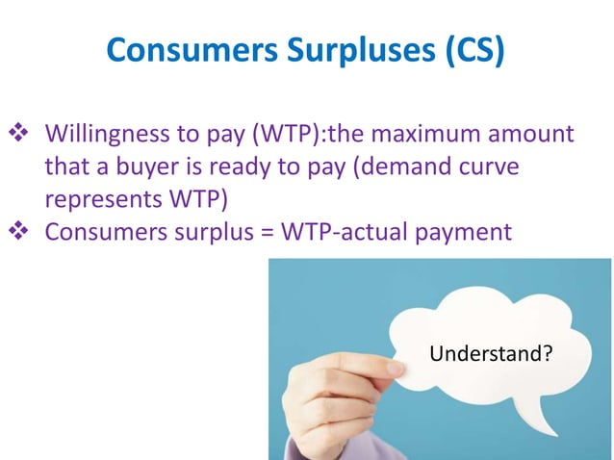

Slide 124
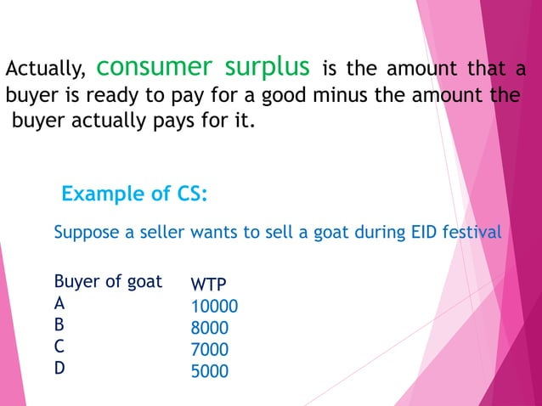

Slide 125
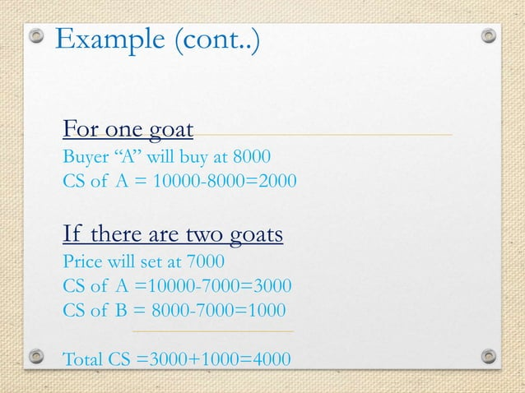

Slide 126
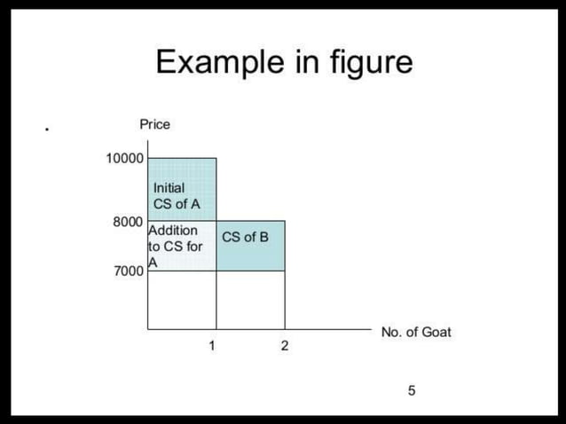

Slide 127
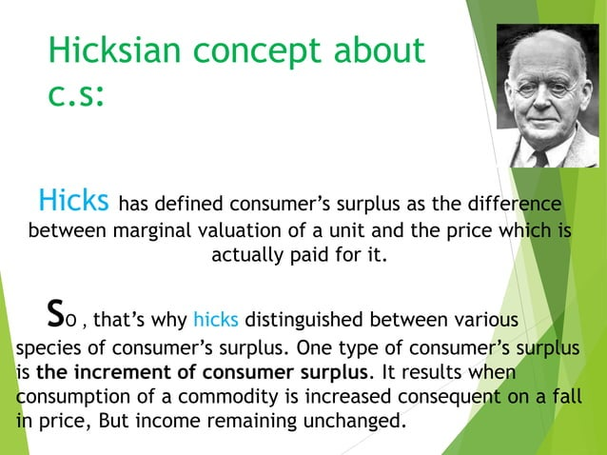

Slide 128
ELASTICITY

Slide 129
PRICE ELASTICITY OF DEMAND
The coefficient of price elasticity of demand (e) measures the percentage change in the quantity of a commodity demanded per unit of time resulting from a given percentage change in the price of the commodity.
Since price and quantity are inversely related, the coefficient of price elasticity of demand is a negative number.
In order to avoid dealing with negative values, a minus sign is often introduced into the formula for e. Letting ΔQ represent the change in the quantity demanded of a commodity resulting from a given change in its price (ΔP), we have

Slide 130
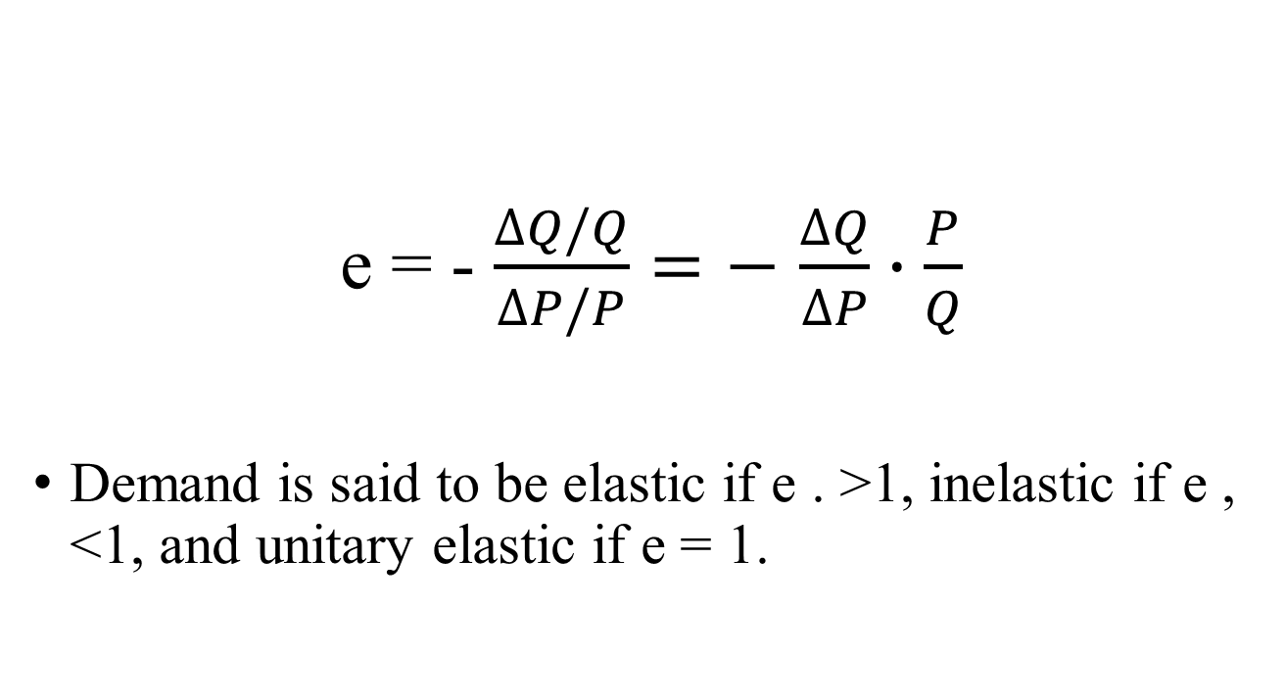
formula for example:
e = - $\frac{∆Q/Q}{∆P/P}=−$ $\frac{∆Q}{∆P}∙\frac{P}{Q}$
Demand is said to be elastic if e . >1, inelastic if e , <1, and unitary elastic if e = 1.

Slide 131
EXAMPLE
Given the market demand schedule in Table below and market demand curve in Fig., we can find elasticity for a movement from point B to point D and from D to B, as follows:

Slide 132
Table and Figure
Point | Px (Rs.) | Qx
A | 8 | 0
B | 7 | 1000
C | 6 | 2000
D | 5 | 3000
F | 4 | 4000
G | 3 | 5000
H | 2 | 6000
L | 1 | 7000
M | 0 | 8000
From B to D and From D to B

Slide 133
From B to D
From D to B

Slide 134
Figure

Slide 135
Movement from point B to point D and from D to B

Slide 136
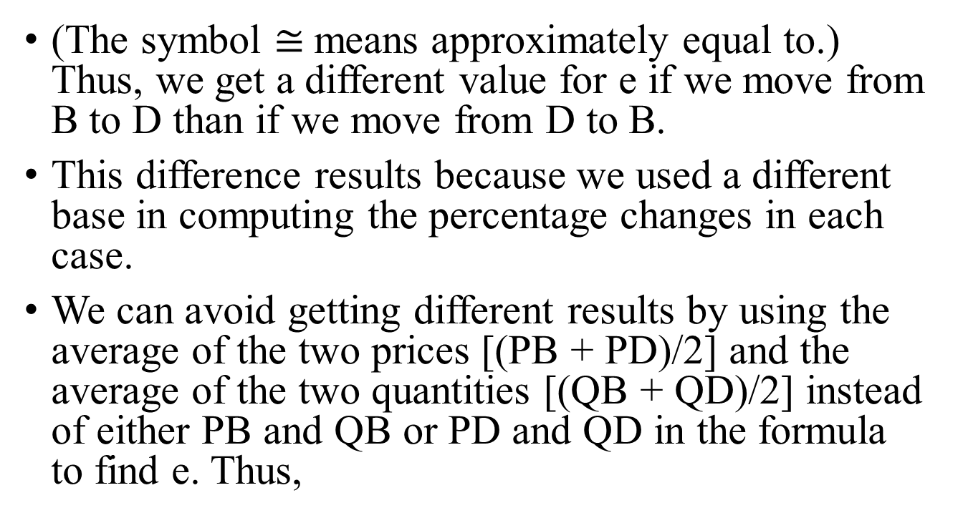
Movement
(The symbol $≅$means approximately equal to.) Thus, we get a different value for e if we move from B to D than if we move from D to B.
This difference results because we used a different base in computing the percentage changes in each case.
We can avoid getting different results by using the average of the two prices [(PB + PD)/2] and the average of the two quantities [(QB + QD)/2] instead of either PB and QB or PD and QD in the formula to find e. Thus,

Slide 137
the formula to find e. Thus,

Slide 138
The formula
Applying this modified formula to find e either for a movement from B to D or for a movement from D to B, we get
This is the equivalent of finding e at the point midway between B and D (i e., at point C).

Slide 139
ARC AND POINT ELASTICITY
The coefficient of price elasticity of demand between two points on a demand curve is called arc elasticity.
Thus, in Examples, we found arc elasticity. Later we will see that the coefficient of price elasticity of demand in general differs at every point along a demand curve. Arc elasticity is, therefore, only an estimate.
This estimate improves as the arc becomes smaller and approaches a point in the limit.
Point elasticity of demand can be found geometrically as shown in Examples

Slide 140
ARC
We can find the elasticity of the demand curve in Example 1 at point C geometrically as follows.
(For easy reference, Fig., with some modifications, is repeated here as Fig.) Since we want to measure elasticity at point C, we have only a single price and a single quantity.

Slide 141
Expressing each of the values in the formula for elasticity in terms of distances, we get:

Slide 142
POINT ELASTICITY AND TOTAL EXPENDITURES
A straight-line demand curve (extended to both axes) is elastic above its midpoint, has unitary elasticity at the midpoint, and is inelastic below its midpoint.
There are no such generalizations for curvilinear demand curves. In the special case when a demand curve takes the shape of a rectangular hyperbola, e = 1 at every point on it.
Regardless of the shape of the demand curve, as the price of a commodity falls, the total expenditures of consumers on the commodity (P times Q) rise when e . >1, remain unchanged when e = 1, and fall when e , <1

Slide 143
POINT ELASTICITY
In Table 3.3, we find e at points B, C, D, F, G, H, and L for the demand curve of Example 1 and
can observe what happens.to total expenditures on commodity X as Px falls. At point B, e = TM/OT = 7000/1000 = 7
The coefficient of price elasticity of Dx at other points is found in a similar way. As we approach point A, e approaches infinity. As we approach point M, e approaches zero.

Slide 144
POINT

Slide 145
INCOME ELASTICITY OF DEMAND
The coefficient of income elasticity of demand (e_{M}) measures the percentage change in the amount of a commodity purchased per unit time (ΔQ/Q) resulting from a given percentage change in a consumer’s income (ΔM/M). Thus;

Slide 146
INCOME ELASTICITY
When e_{M} is negative, the good is inferior. If e_{M} is positive, the good is normal.
A normal good is usually a luxury if its e_{M} . >1, otherwise it is a necessity.
Depending on the level of the consumer’s income, e_{M} for a good is likely to vary considerably.
Thus a good may be a luxury at “low” levels of income, a necessity at “intermediate” levels of income and an inferior good at “high” levels of income.

Slide 147
CROSS ELASTICITY OF DEMAND
The coefficient of cross elasticity of demand of commodity X with respect to commodity Y(e_{xy}) measures the percentage change in the amount of X purchased per unit of time (ΔQx/Qx) resulting from a given percentage change in the price of Y(Δ Py/Py). Thus;

Slide 148
Price Elasticity of Demand
Measures buyers’ responsiveness to price changes
Elastic demand
Sensitive to price changes
Large change in quantity
Inelastic demand
Insensitive to price changes
Small change in quantity

Slide 149
Price Elasticity of Demand Formula
Formula for price elasticity of demand
E_{d} =
Percentage Change in Quantity
Demanded of Product X
Percentage Change in Price
of Product X

Slide 150
Price Elasticity of Demand Formula
Use the midpoint formula
Ensures consistent results
Change in quantity Change in price
Sum of quantities / 2 Sum of prices / 2
E_{d} =
÷

Slide 151
Interpretation of Elasticity of Demand
E_{d} > 1 demand is elastic
E_{d} = 1 demand is unit elastic
E_{d} < 1 demand is inelastic
Extreme cases
Perfectly inelastic
Perfectly elastic

Slide 152

Extreme Cases
P
D₁
Perfectly inelastic demand
(Ed = 0)
0
Perfectly inelastic demand

Slide 153
Extreme Cases
P
D₂
Perfectly elastic
demand
(Ed = ∞)
0
Perfectly elastic demand

Slide 154
Total Revenue Test
Total Revenue = Price x Quantity
Inelastic demand
P and TR move in the same direction
Elastic demand
P and TR move in opposite directions

Slide 155
Summary of Price Elasticity of Demand
Price Elasticity of Demand: A Summary
Absolute Value of Elasticity Coefficient | Demand Is | Description | Impact on Total Revenue of a:
 |  |  | Price Increase | Price Decrease
Greater than 1 (E_{d} > 1) | Elastic or relatively elastic | Q_{d} changes by a larger percentage than does price | Total revenue decreases | Total revenue increases
Equal to 1 (E_{d} = 1) | Unit or unitary elastic | Q_{d} changes by the same percentage as does price | Total revenue is unchanged | Total revenue is unchanged
Less than 1 (E_{d} < 1) | Inelastic or relatively inelastic | Q_{d} changes by a smaller percentage than does price | Total revenue increases | Total revenue decreases

Slide 156
Determinants of Elasticity of Demand
Substitutability
More substitutes, demand is more elastic
Proportion of Income
Higher proportion of income, demand is more elastic
Luxuries vs. Necessities
Luxury goods, demand is more elastic
Time
More time available, demand is more elastic

Slide 157
Price Elasticity of Supply
The coefficient of price elasticity of supply (e_{s}) measures the percentage change in the quantity supplied of a commodity per unit of time (ΔQ=Q) resulting from a given percentage change in the price of the commodity (ΔP=P). Thus;

Slide 158
Price Elasticity of Supply

Slide 159
Price Elasticity of Supply
When the supply curve is positively sloped (the usual case), price and quantity move in the same direction and e_{s} >0.
The supply curve is said to be elastic if e_{s} >1, inelastic if es , <1, and unitary elastic if es = 1.
Arc and point e_{s} can be found in the same way as arc and point e. When the supply curve is a positively sloped straight line, then, all along the line, e_{s} >1, if the line crosses the price axis; e_{s} ,< 1, if it crosses the quantity axis; and e_{s} = 1, if it goes through the origin.

Slide 160
EXAMPLE
To find ex for a movement from point A to point C, from C to A and midway between A and C (i.e., at point B) and midway between C and F (i.e., at point D) for the values of Table, we proceed as follows:

Slide 161
EXAMPLE
Point | Px (Rs.) | Qx
A | 6 | 800
B | 5 | 600
C | 4 | 400
D | 3 | 200
F | 2 | 0

Slide 162
EXAMPLE

Slide 163
EXAMPLE
We can find es at points B and D geometrically from

Slide 164
EXAMPLE
To find point es, for a curvilinear supply curve, we draw a tangent to the supply curve at the point and then proceed as above.

Slide 165
Price Elasticity of Supply
Formula to compute elasticity
E_{s} > 1 supply is elastic
E_{s} < 1 supply is inelastic
Percentage Change in Quantity
Supplied of Product X
E_{s} =
Percentage Change in Price
of Product X

Slide 166
SR Versus LR Elasticities
Price Elasticity of Demand
Price elasticity of demand be different with the amount of time consumers have to respond to a price.
Most goods and services:
Short-run elasticity is less than long-run elasticity (e.g. gasoline). People tend to drive lesser and more fuel efficient cars in the long-run
Other Goods (durables):
Short-run elasticity is greater than long-run elasticity (e.g. automobiles). People may put off immediate consumption, but ultimately older cars must be replaced.
Notes:
85

Slide 167
SR Versus LR Elasticities
Income Elasticities
Most goods and services:
Income elasticity is greater in the long-run than in the short run. For example, higher incomes may be converted into bigger cars so the income elasticity of demand for gasoline increases with time.
Other Goods (durables):
Income elasticity is less in the long-run than in the short-run. For example, consumers will initially want to hold more cars. Later, purchases will only to be to replace old cars.
Notes:
89

Slide 168
SR Versus LR Elasticities
Price Elasticity of Supply
Most goods and services:
Long-run price elasticity of supply is greater than short-run price elasticity of supply. Due to limited capacity, firms are output constrained in the short-run. In the long-run, they can expand.
Other Goods (durables, recyclables):
Long-run price elasticity of supply is less than short-run price elasticity of supply. For example, consider the secondary copper market. Copper price increases provide an incentive to convert row copper into new supply. In the long-run, this stock of row copper begins to fall.
Notes:
96

Slide 169
Demand under conditions of risk and uncertainty
The problem of imperfect information
Attitudes towards risk
Diminishing marginal utility and attitudes to risk
Insurance: a way of removing risks
Problems for irresponsible insurance companies

Slide 170
Risk and Uncertainty
The risk is defined as the situation of winning or losing something worthy.
Uncertainty is a condition where there is no knowledge about the future events.
Risk can be measured and quantified, through theoretical models.
Conversely, it is not possible to measure uncertainty in quantitative terms, as the future events are unpredictable.
The potential outcomes are known in risk,
whereas in the case of uncertainty, the outcomes are unknown.

Slide 171
Risk and Uncertainty
Risk can be controlled if proper measures are taken to control it.
On the other hand, uncertainty is beyond the control of the person or enterprise, as the future is uncertain.
Minimization of risk can be done, by taking necessary precautions.
As opposed to the uncertainty that cannot be minimized.
In risk, probabilities are assigned to a set of circumstances which is not possible in case of uncertainty.

Slide 172
Risk and Uncertainty
BASIS FOR COMPARISON | RISK | UNCERTAINTY
Meaning | The probability of winning or losing something worthy is known as risk. | Uncertainty implies a situation where the future events are not known.
Certainty | It can be measured | It cannot be measured.
Outcome | Chances of outcomes are known. | The outcome is unknown.
Control | Controllable | Uncontrollable
Minimization | Yes | No
Probabilities | Assigned | Not assigned

Slide 173
THANK YOU
NEXT UNIT II

